Slide 1


POLAR CURVES
Math 14
Plane and Solid Analytic Geometry

Slide 2
OBJECTIVES:
At the end of the lesson, the student is expected to be able to:
• define polar coordinates.
• plot points of polar coordinates.
• write and sketch the graphs of polar equations.
• convert polar to rectangular and vice versa.

Slide 3
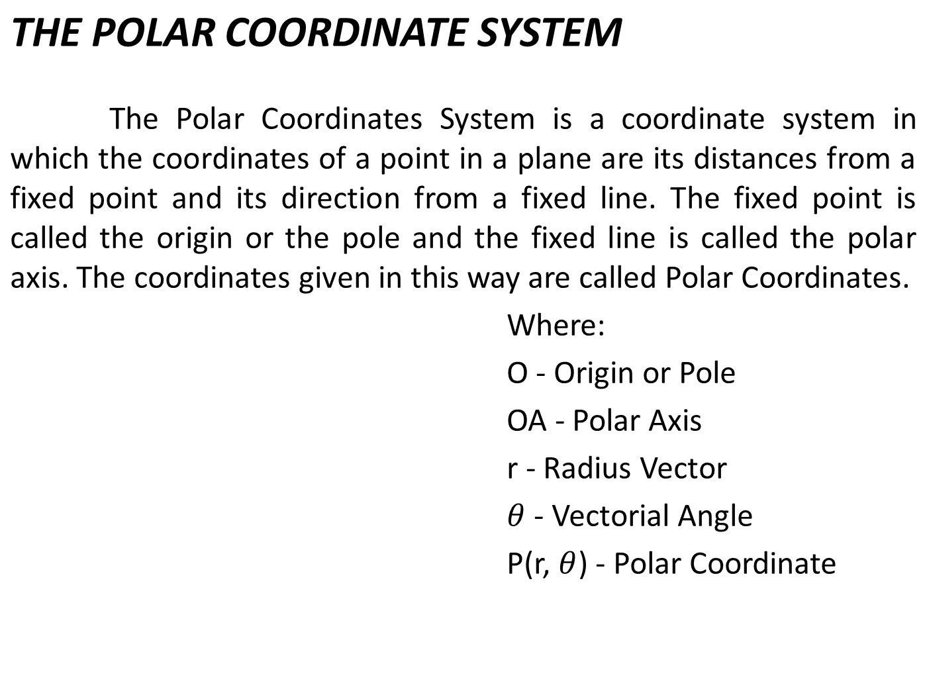
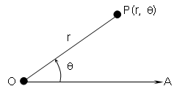

Slide 4
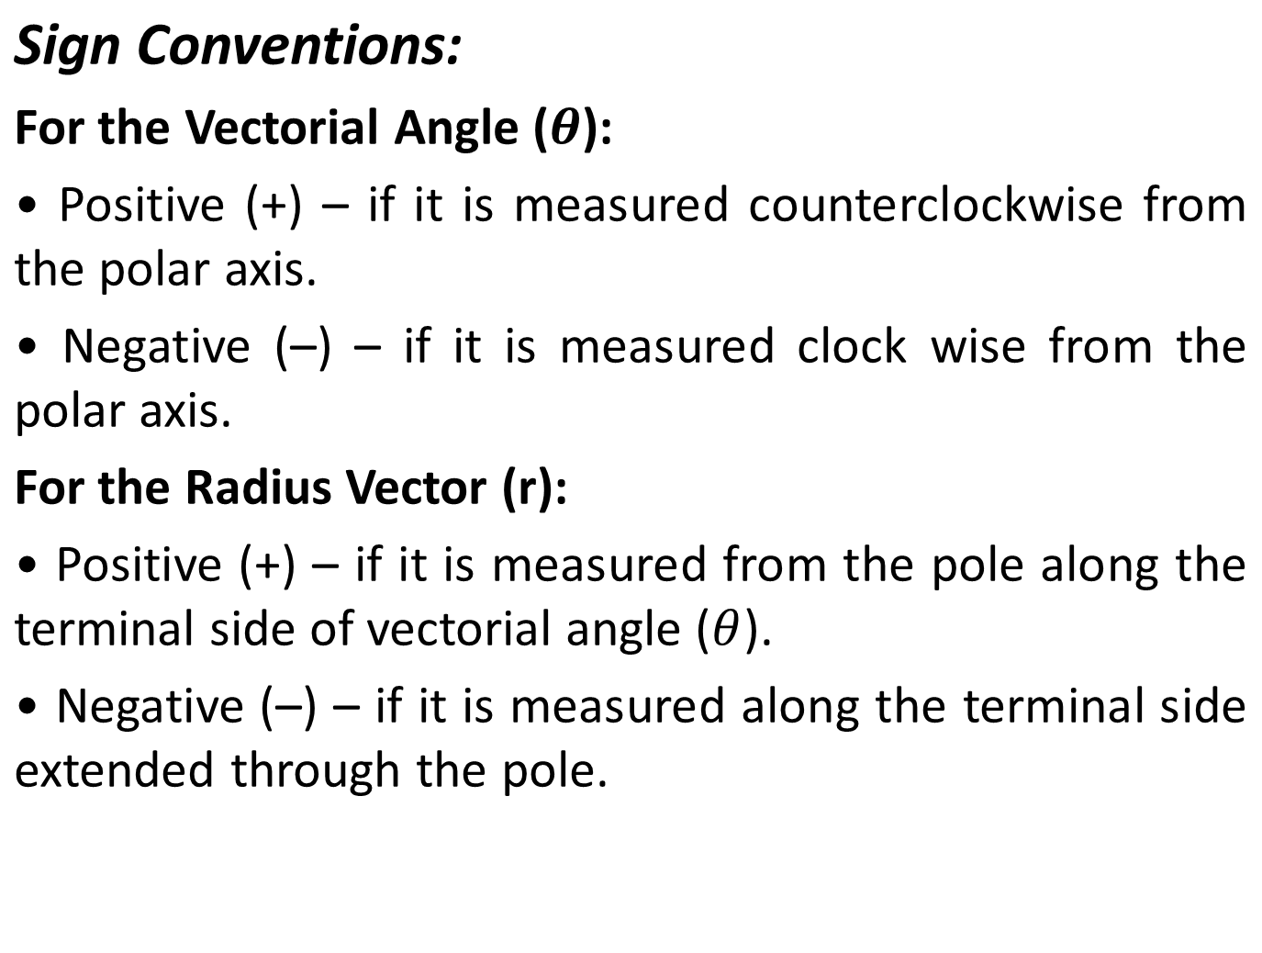

Slide 5
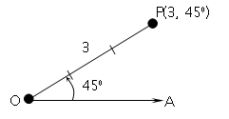
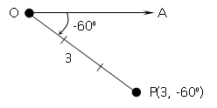
Examples: Plot the given points on a polar coordinate system.
P (3, 45°)
b. P (3, –60°)

Slide 6
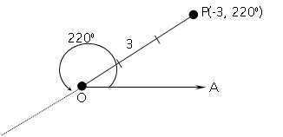
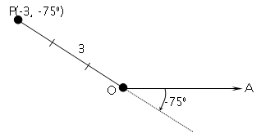
c. P (–3, 220°)
d. P (-3, –75°)

Slide 7


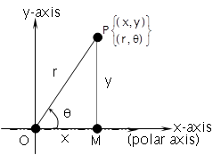
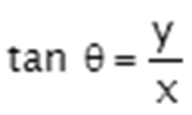
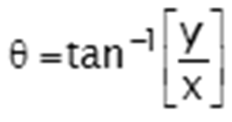
RELATIONS BETWEEN RECTANGULAR AND POLAR COORDINATES
The transformation formulas that express the relationship between rectangular coordinates and polar coordinates of a point are as follows:
and
Also,
;
;

Slide 8
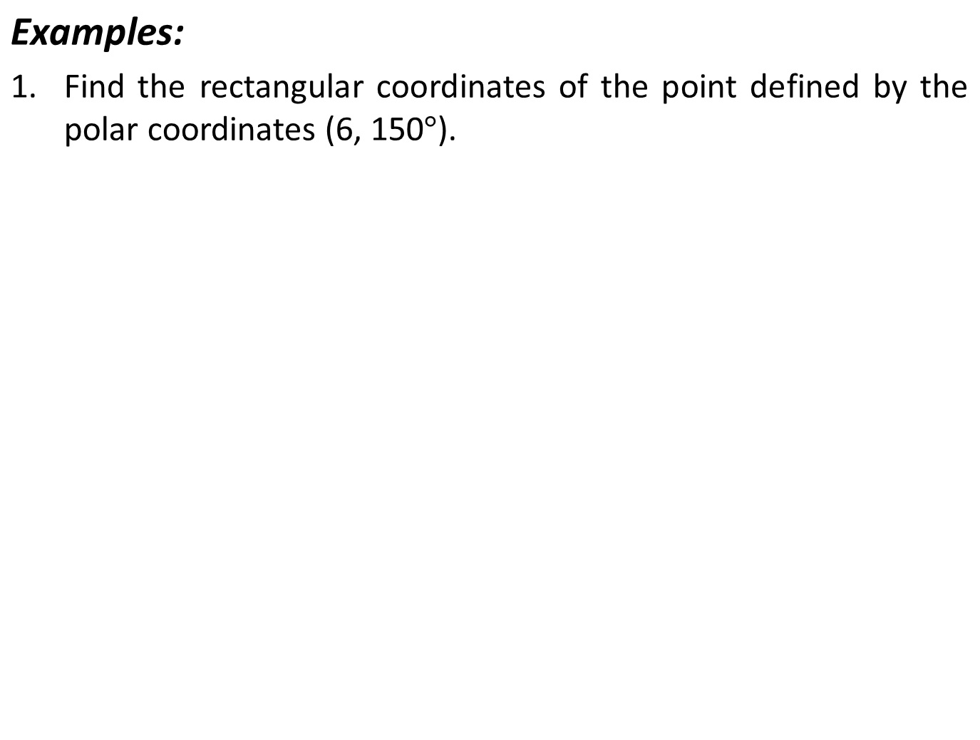
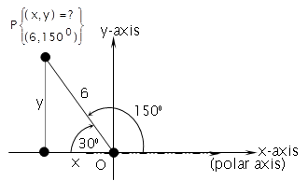
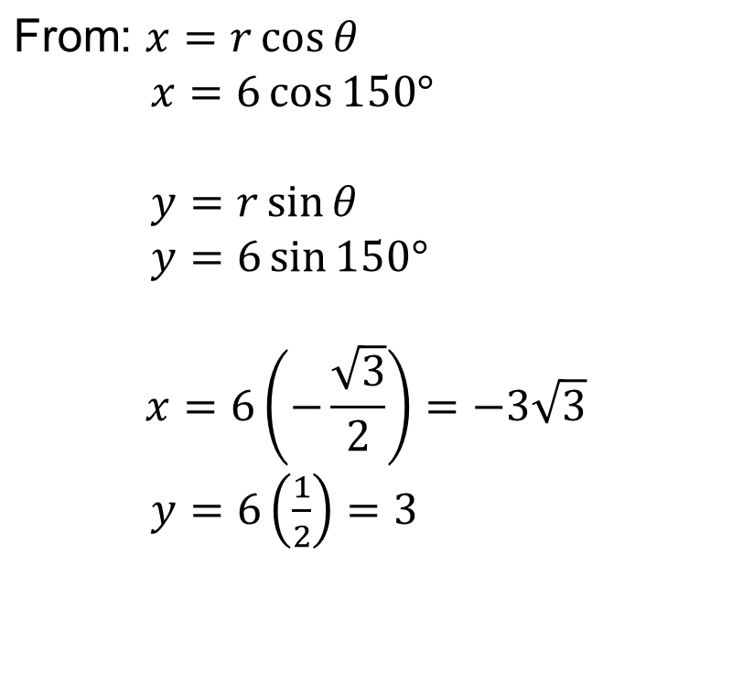

Slide 9
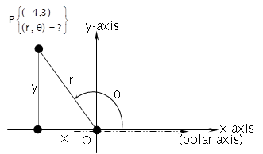
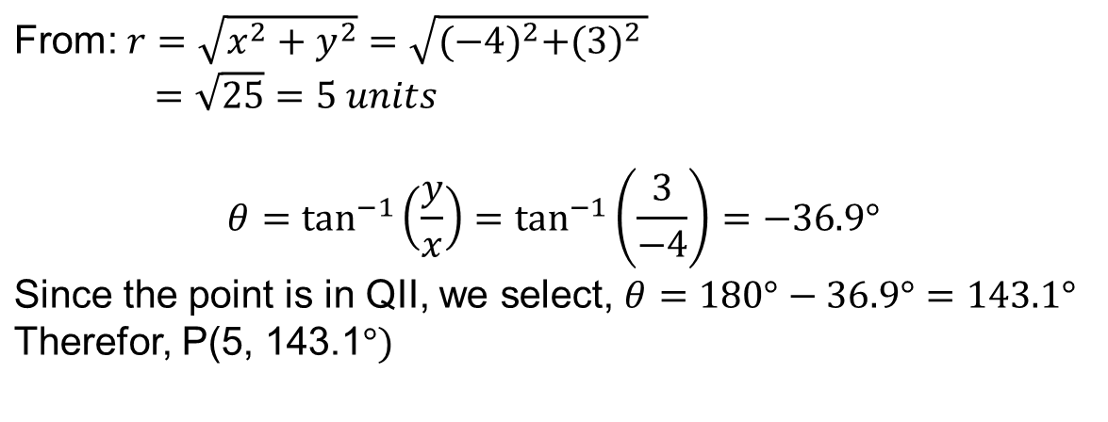
2. Express the rectangular coordinates (-4, 3) in terms of polar coordinates.
Therefore, P(5, 143.1⁰)

Slide 10
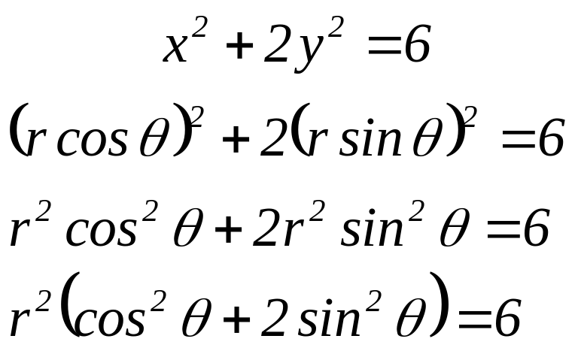
3. Find the polar coordinate equation corresponding to x² + 2y² = 6.
substituting: x = r cos θ and y = r sin θ, we have

Slide 11
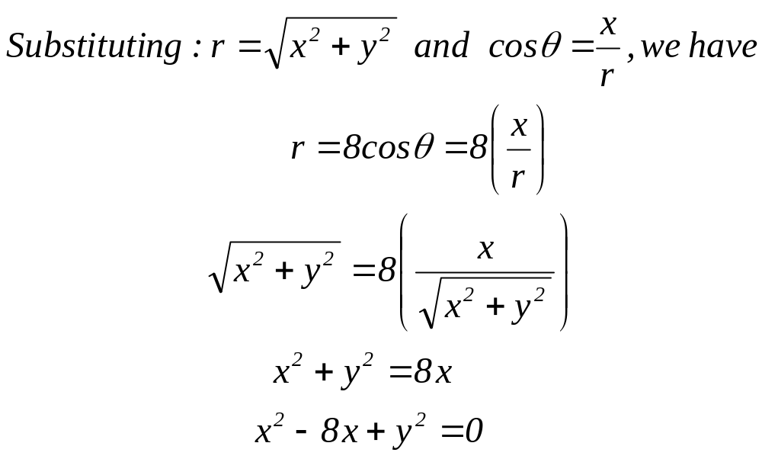
4. Transform the equation r = 8 cos θ to rectangular coordinate equation.

Slide 12
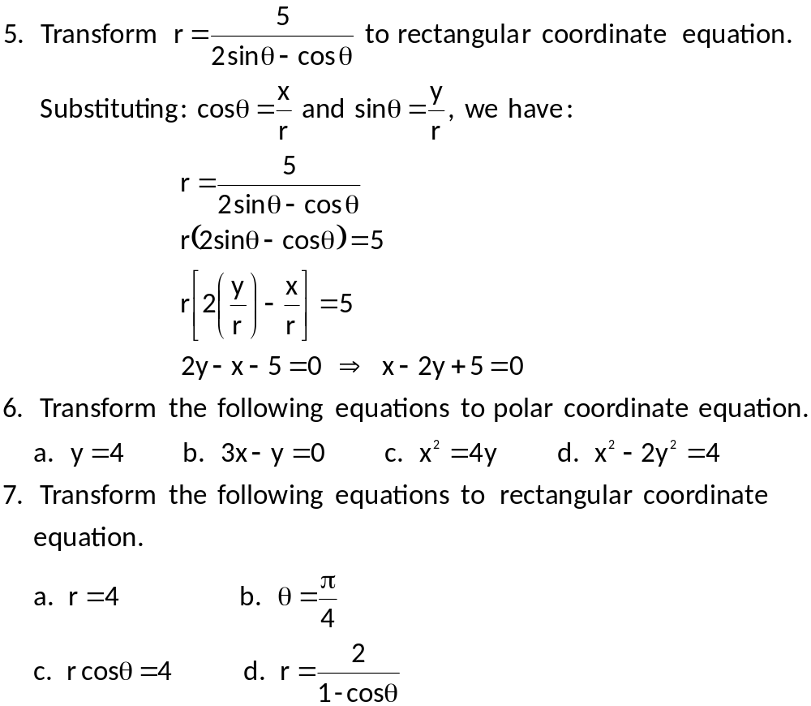

Slide 13
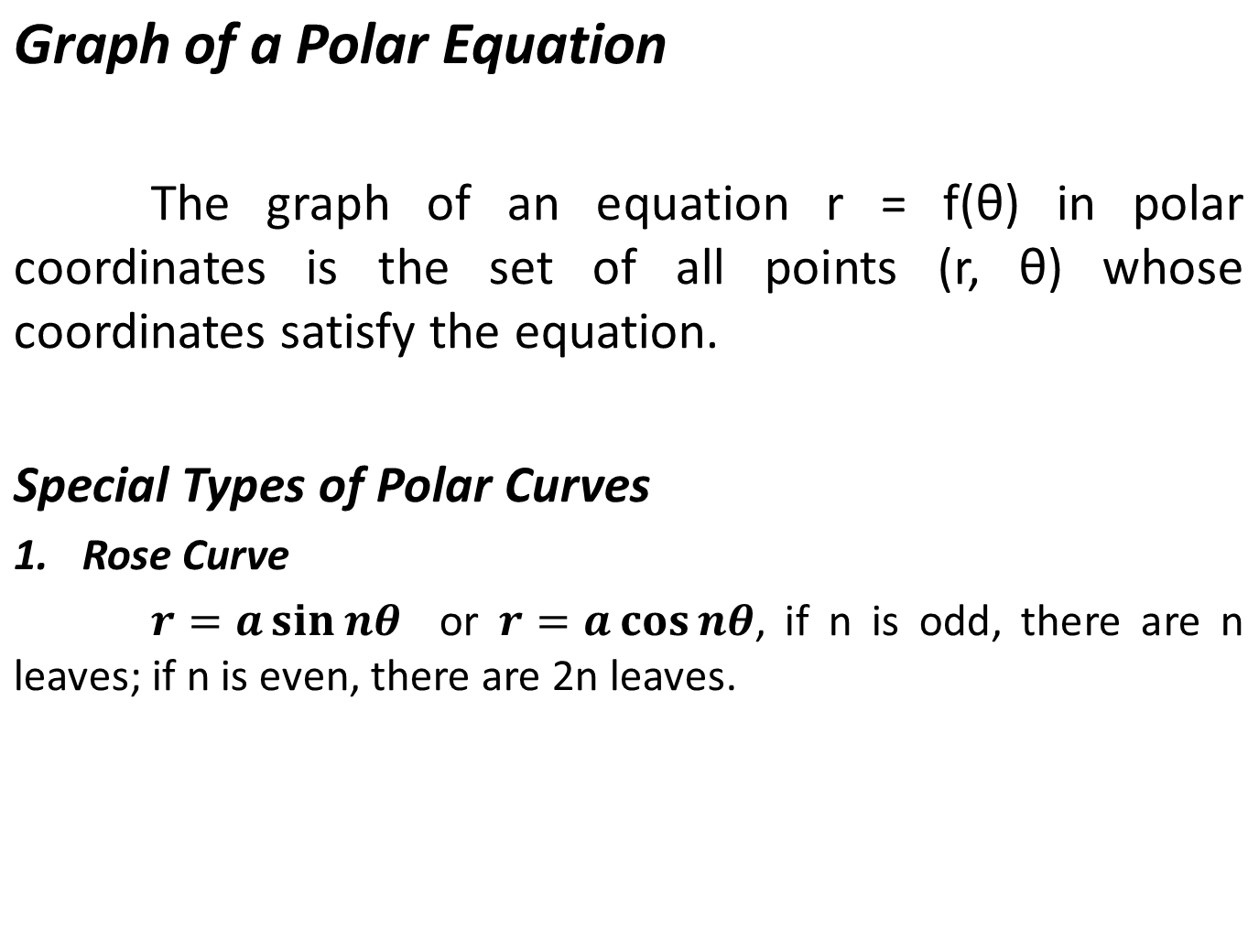

Slide 14
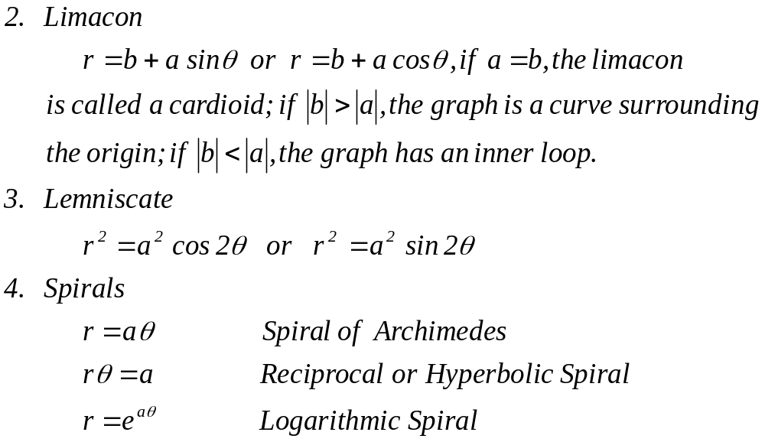

Slide 15
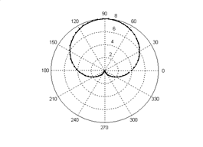
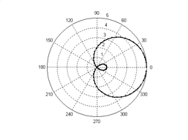
Cardioid
Limacon

Slide 16
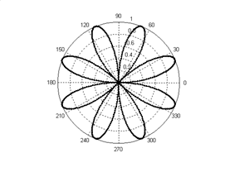
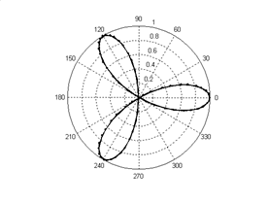
Eight – leaf Rose
Three – leaf Rose

Slide 17
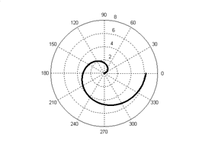
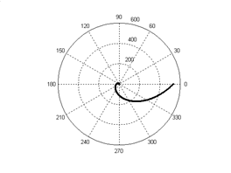
Spiral of Archimedes
Logarithmic Spiral

Slide 18
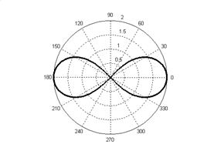
Lemniscate

Slide 19
Example 1:
Trace r = 1 + 2 cosθ
θ | 0⁰ | 30⁰ | 60⁰ | 90⁰ | 120⁰ | 150⁰ | 180⁰ | 210⁰ | 240⁰ | 270⁰ | 300⁰ | 330⁰ | 360⁰
cosθ | 1 | 0.87 | 0.5 | 0 | -0.5 | -0.87 | -1 | -0.87 | -0.5 | 0 | 0.5 | 0.87 | 1
2cosθ | 2 | 1.73 | 1 | 0 | -1 | -1.73 | -2 | -1.73 | -1 | 0 | 1 | 1.73 | 2
r | 3 | 2.73 | 2 | 1 | 0 | -0.73 | -1 | -0.73 | 0 | 1 | 2 | 2.73 | 3

Slide 20
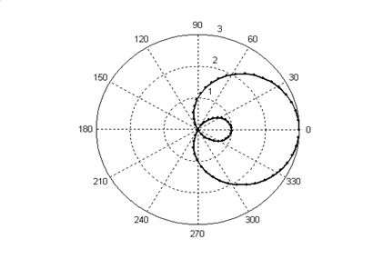

Slide 21
Example 2:
Construct the graph r = cos3θ.
θ | 0⁰ | 30⁰ | 60⁰ | 90⁰ | 120⁰ | 150⁰ | 180⁰ | 210⁰ | 240⁰ | 270⁰ | 300⁰ | 330⁰ | 360⁰
3θ | 0⁰ | 90⁰ | 180⁰ | 270⁰ | 360⁰ | 450⁰ | 540⁰ | 630⁰ | 720⁰ | 810⁰ | 900⁰ | 990⁰ | 1080⁰
cos3θ | 1 | 0 | -1 | 0 | 1 | 0 | -1 | 0 | 1 | 0 | -1 | 0 | 1

Slide 22
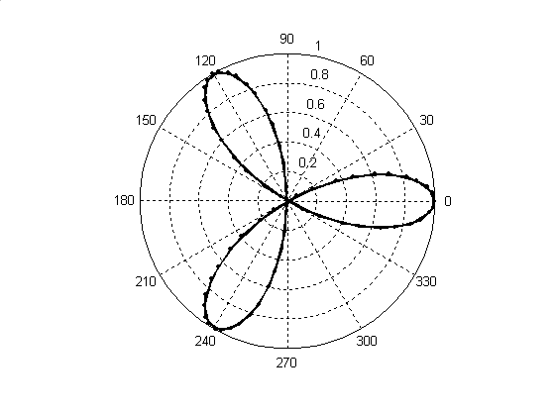

Slide 23
Example 3:
Construct the graph r² = 4 cos 2θ.
θ | 0⁰ | 30⁰ | 60⁰ | 90⁰ | 120⁰ | 150⁰ | 180⁰ | 210⁰ | 240⁰ | 270⁰ | 300⁰ | 330⁰ | 360⁰
2θ | 0⁰ | 60⁰ | 120⁰ | 180⁰ | 240⁰ | 300⁰ | 360⁰ | 420⁰ | 480⁰ | 540⁰ | 600⁰ | 660⁰ | 720⁰
cos2θ | 1 | 0.5 | -0.5 | -1 | -0.5 | 0.5 | 1 | 0.5 | -0.5 | -1 | -0.5 | 0.5 | 1
4cos2θ | 4 | 2 | -2 | -4 | -2 | 2 | 4 | 2 | -2 | -4 | -2 | 2 | 4
r | 2 | 1.4 | i | i | i | 1.4 | 2 | 1.4 | i | i | i | 1.4 | 2

Slide 24
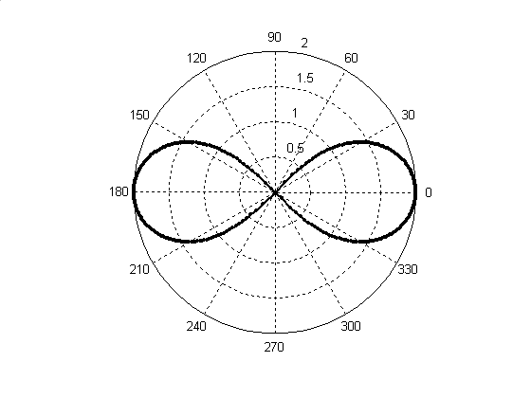

Slide 25
REFERENCES
Analytic Geometry

